Slide 1

WEB DEVELOPMENT OF BASICS
➪HTML ➪CSS ➪JAVASCRIPT

Slide 2

INTRODUCTION TO WEB DEVELOPMENT
Web delopment is process of Creating website or web application for the internet.
It involves buliding, designing and maintaining web pages.
The Three of buliding blocks:-
➪ 𝐇𝐓𝐌𝐋 can be structure of content (Heading, Text , Paragraph, Links ).
➪𝐂𝐒𝐒 are control to ( Fronts, Colour, Layout, Spacing).
➪𝐉𝐀𝐕𝐀𝐒𝐂𝐑𝐈𝐏𝐓 makes its interactive and dynamic behaviour as (Buttons,animation).

Slide 3
INTRODUCTION TO HTML
HTML stands for (Hyper Text Markup Language).
Its a standard langauge for creating webpages.
HTML structure content on the web.

Slide 4
HTML CONCEPTS AND FEATURES
𝐇𝐓𝐌𝐋 𝐂𝐎𝐍𝐂𝐄𝐏𝐓𝐒 :-
» 𝑬𝒍𝒆𝒎𝒆𝒏𝒕𝒔 : Buliding blocks of HTML.
» 𝑻𝒂𝒈𝒔: Define structure (<h1>,<P>,<div>).
» 𝑨𝒕𝒕𝒓𝒊𝒃𝒖𝒕𝒆𝒔: Provide additional information (<imgsrc=“.......”>).
𝐇𝐓𝐌𝐋 𝐅𝐄𝐀𝐓𝐔𝐑𝐄𝐒:-
»Simple and easy to learn.
»Platform of independent.
»Supports multimedia (Image, Videos, Audio ).
»Forms for user 𝑰𝒏𝒑𝒖𝒕.

Slide 5
HTML TAGS
< h1>–<h6> → headings<p> → paragraph<a> → hyperlink<img> → image<ul>, <ol>, <li> → lists<table> → tables<form> → forms and inputs

Slide 6
ADVANTAGES OF HTML
Widely used and supported by all browsers.
Integrates easily with CSS and JavaScript.Open-source and free.SEO-friendly structure.

Slide 7
EXAMPLE FOR HTML
<!DOCTYPE html>
<html>
<head><title>My First Page</title></head>
<body><h1>Hello World!</h1></body>
</html>

Slide 8
INTRODUCTION TO CSS
CSS stands for (Cascading Style Sheets).It controls the look and feel of webpages.
Separates content from design.

Slide 9
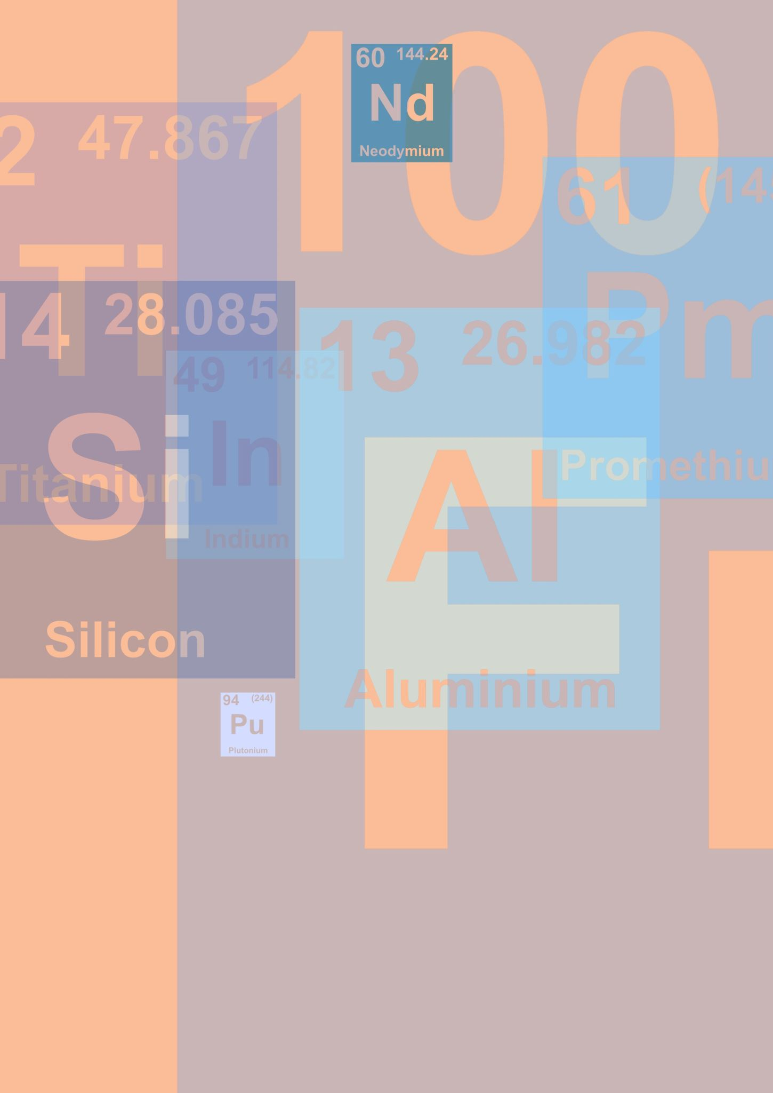
𝐂𝐒𝐒 CONCEPTS AND FEATURES
𝐂𝐒𝐒 𝐂𝐎𝐍𝐂𝐄𝐏𝐓𝐒:-
» 𝑺𝒆𝒍𝒆𝒄𝒕𝒐𝒓𝒔: Target HTML elements.
» 𝑷𝒓𝒐𝒑𝒆𝒓𝒕𝒊𝒆𝒔: Define styles (color, font-size).
» 𝑽𝒂𝒍𝒖𝒆𝒔: Assign to properties (red, 16px).
» 𝑻𝒚𝒑𝒆𝒔: Inline, Internal, External.
𝐂𝐒𝐒 𝐅𝐄𝐀𝐓𝐔𝐑𝐄𝐒:-
»Provides consistent design.
»Supports responsive layouts.
»Reduces code repetition.
»Supports animations and transition.

Slide 10
TYPES OF CSS
1.𝐈𝐧𝐥𝐢𝐧𝐞 𝐂𝐒𝐒 :-
★Applied directly to an HTML element using the `style` attribute.
2.𝐈𝐧𝐭𝐞𝐫𝐧𝐚𝐥 𝐂𝐒𝐒 :-
★Defined within the `<head>` section of an HTML document using the `<style>` tag.3.𝐄𝐱𝐭𝐞𝐫𝐧𝐚𝐥 𝐂𝐒𝐒 :-
★Defined in a separate CSS file (e.g., `styles.css`) and linked to an HTML document using the `<link>` tag.

Slide 11
ADVANTAGES OF CSS
Saves time with reusable styles.
Improves page speed.
Easier maintenance and updates.
Better user experience.

Slide 12
EXAMPLE FOR CSS
h1 {
color: blue;
text-align: center;
}

Slide 13
INTRODUCTION TO JAVASCRIPT
JavaScript is a programming language for the web.
It adds interactivity to websites.
Runs on all modern browsers.

Slide 14
JAVASCRIPT CONCEPTS AND FEATURES
𝐉𝐀𝐕𝐀𝐒𝐂𝐑𝐈𝐏𝐓 𝐂𝐎𝐍𝐂𝐄𝐏𝐓𝐒 ;-
★Variables and Data Types.
★Functions and Events.
★DOM Manipulation.
★Conditional Statements and Loops.
𝐉𝐀𝐕𝐀𝐒𝐂𝐑𝐈𝐏𝐓 𝐅𝐄𝐀𝐓𝐔𝐑𝐄𝐒:-
★Lightweight and fast.
★Object-oriented capabilities.
★Supports event-driven programming.
★Can interact with HTML and CSS.

Slide 15
ADVANTAGES OF JAVASCRIPT
Client-side execution reduces server load.
Highly versatile with frameworks and libraries.
Cross-platform compatibility.
Improves interactivity.

Slide 16

EXAMPLE FOR JAVASCRIPT
<script>
function greet()
{
alert(‘Hello, welcome to JavaScript!’);
}
</script>

